Slide 1
Analysis and Design
Network Simulator

Slide 2

Response 1
Router 1
Req 1 source = 1
Request Dispatcher
Response
Manager
Req 2 source = 2
Router 2
Response 2
For dispatching
For releasing
Ticker
Reroute

Slide 3
Components
Network Components
Routing Components
Simulator Components

Slide 4
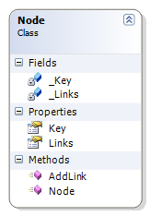
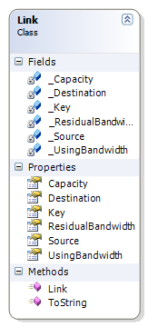
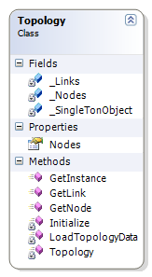
Network Components
Include all network models such as: Link, Node, Topology.

Slide 5
Routing Components
Include two subcomponents.
Algorithms
Include all algorithms that used for routing strategy such as: Breadth First Search, Dijkstra, Ford Fulkerson ... etc
Routing Components
Routing Strategy
Include all routing strategy, such as MHA. MIRA, DORA … etc

Slide 6
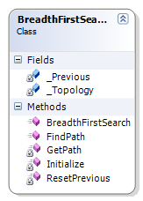
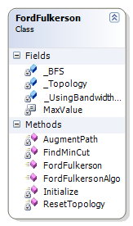
Routing Components
Algorithms

Slide 7
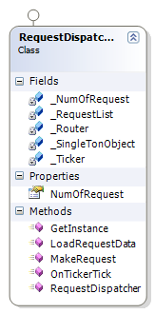
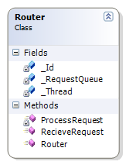
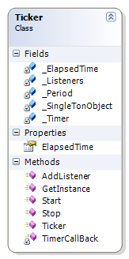
Simulator Components
Include all simulator objects such as: Router, RequestDispatcher, Ticker …

Slide 8
Algorithms
Simulator Components
Routing Components
1
2
Routing Strategy
3
Network Components
Simulate
Test

Slide 9
Relationship

Slide 10
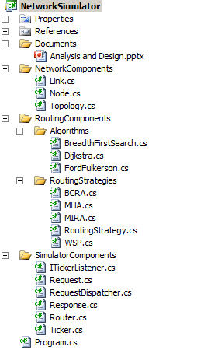
Project Overview

